Slide 1
Continuous Probability Distributions
Shovan Bhowmik
Lecturer
Dept. of CSE, baiust

Slide 2
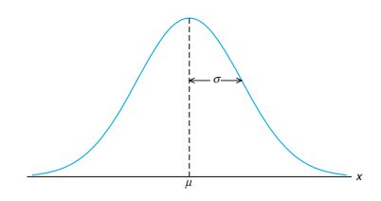
Normal Distribution
Most widely used model for a continuous measurement.
According to Central Limit Theorem, sums and averages often have approximately Normal distribution.
Also referred to as a Gaussian distribution.
It’s graph, called the normal curve, is the bell-shaped curve.

Slide 3

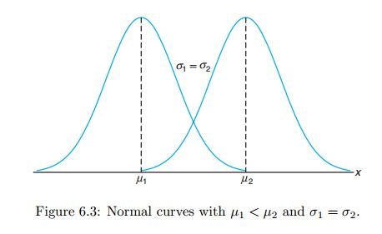
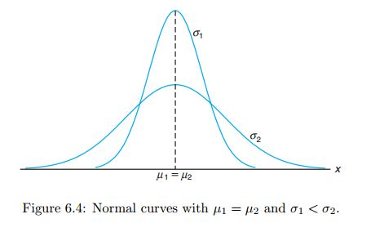
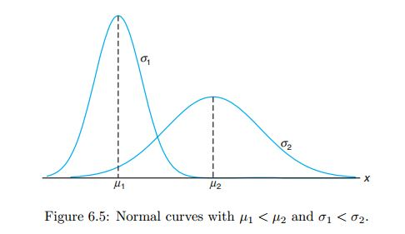
Normal Distribution(Cont..)
The density of the normal random variable X, with mean μ and variance σ², is:

Slide 4
Normal Distribution(Cont..)
Properties of Normal Curve:
The mode, which is the point on the horizontal axis where the curve is a maximum, occurs at x=μ.
The curve is symmetric about a vertical axis through the mean μ.
The curve has its points of inflection at x = μ±σ; it is concave downward if μ−σ < X < μ+σ and is concave upward otherwise.
The normal curve approaches the horizontal axis asymptotically as we proceed in either direction away from the mean.
The total area under the curve and above the horizontal axis is equal to 1.

Slide 5

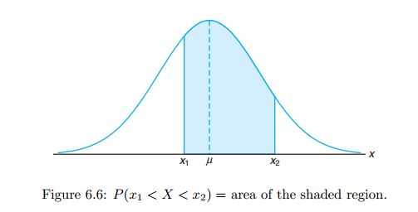
Normal Distribution(Cont..)
Areas under the normal curve:

Slide 6


Normal Distribution(Cont..)
Normal distribution with “standard parameters” µ = 0 and σ = 1 is called Standard Normal distribution.
Z = Standard Normal random variable
if X falls between the values x=x1 and x=x2, the random variable Z will fall between the corresponding values z1 = (x1−μ)/σ and z2 = (x2−μ)/σ.

Slide 7
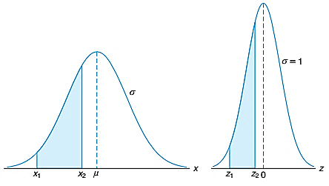
Normal Distribution(Cont..)
We can reconstruct the initial variable X, X = µ + σ Z

Slide 8
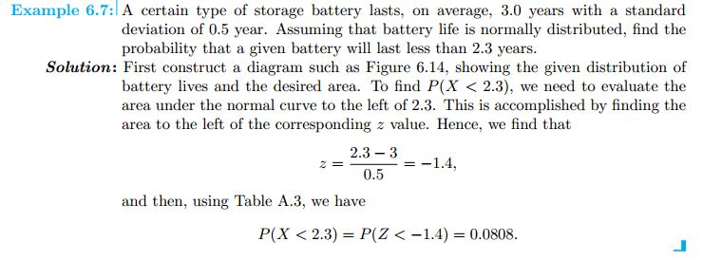
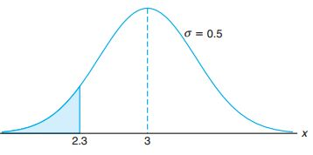
Normal Distribution(Cont..)

Slide 9
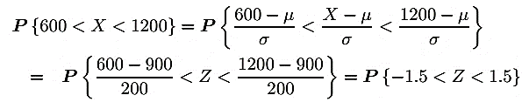
Normal Distribution(Cont..)
Example:
Suppose that the average household income in some country is 900 coins, and the standard deviation is 200 coins. Assuming the Normal distribution of incomes, compute the proportion of “the middle class,” whose income is between 600 and 1200 coins.
Solution: Given that, µ = 900, σ = 200

Slide 10

Normal Distribution(Cont..)
Example(Inverse Problem):
The government of the country in last example decides to issue food stamps to the poorest 3% of households. Below what income will families receive food stamps?
Solution: We need to find such income x that P {X < x} = 3% = 0.03. This is an equation that can be solved in terms of x. Again, we standardize first, then use the table:

Slide 11
Exponential Distribution
Poisson distribution is used to compute the probability of specific numbers of “events” during a particular period of time or span of space.
Exponential distribution is often used to model time:
waiting time
inter-arrival time
hardware lifetime
failure time
time between telephone calls etc.

Slide 12
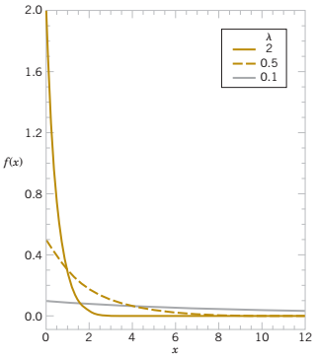
Exponential Distribution(Cont..)
The random variable X that equals the distance between successive events from a Poisson process with mean number of events λ > 0 per unit interval is an exponential random variable with parameter λ.
The probability density function of X is
f(x)= λe^{−λx} for 0 ≤x< ∞

Slide 13
Exponential Distribution(Cont..)
Poisson Distribution vs Exponential Distribution:
The Poisson distribution deals with the number of occurrences in a fixed period of time, and the exponential distribution deals with the time between occurrences of successive events as time flows by continuously.
The Poisson distribution is discrete and the Exponential distribution is continuous.
The Exponential distribution also describes the time between events in a Poisson process.
For example, the incoming stream of passengers in metro station is Poisson and the time of service of passengers is exponential.

Slide 14





Exponential Distribution(Cont..)
Cumulative Density Function:
Mean and Variance:
Mean:
Variance:

Slide 15
Exponential Distribution(Cont..)
Example:
Jobs are sent to a printer at an average rate of 3 jobs per hour. (a) What is the expected time between jobs?
(b) What is the probability that the next job is sent within 5 minutes?
Solution:
T = time between Job arrivals, λ = 3
E(T) =1/λ = 1/3hours or 20 minutes between jobs
5 min = (1/12) hrs
P {T < 1/12 hrs} = F (1/12) = 1 - e^{-λ(1/12)} = 1 - e^{-1/4} = 0.2212

Slide 16

Exponential Distribution(Cont..)
Memoryless Property:
Suppose that an exponential variable T represents waiting time.
Memoryless property means that the fact of having waited for t minutes gets “forgotten,” and it does not affect the future waiting time.
t is the already elapsed waiting time, and x is the additional time.

Slide 17
Exponential Distribution(Cont..)
Example:
Let X denote the time between detections of a particle with a Geiger counter and assume that X has an exponential distribution with E(X) = 1. 4 minutes. What is the probability that we detect a particle within 30 seconds of starting the counter ?
Solution:
Now, suppose that we turn on the Geiger counter and wait three minutes without detecting a particle. What is the probability that a particle is detected in the next 30 seconds?

Slide 18



Exponential Distribution(Cont..)
Solution:

Slide 19
Math Problems needed to solve
Walpole Book:
Examples: 6.2, 6.4, 6.5, 6.6, 6.17
Exercises: 6.11, 6.12, 6.14, 6.17, 6.19, 6.20, 6.45, 6.64, 6.81
Slide Math

Slide 20
References
Probability and Statistics for Engineers and Scientists(9th Edition) – Walpole
Probability and Statistics for Engineers and Scientists(4th Edition) – Sheldon Ross
Internet Resources

Slide 21


